Slide 1
FRB Update
William Huang
(8/19/2020)

Slide 2
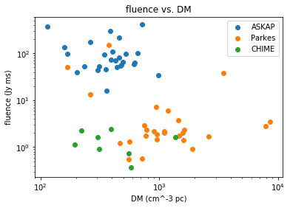
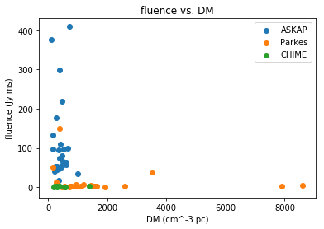
Fluence vs. DM
I added CHIME FRBs, and I also included a log-log version of the same plot because the distinction was a little hard to see.

Slide 3
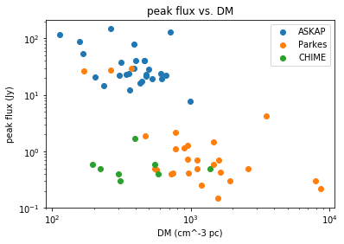
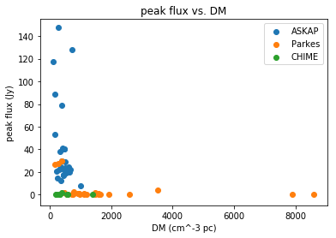
Peak flux vs. DM
Here are graphs of peak flux vs. DM. Overall the general locations of each telescope are very similar.

Slide 4
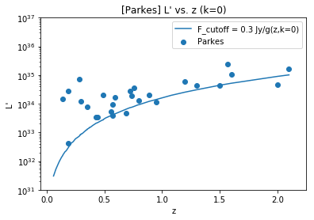
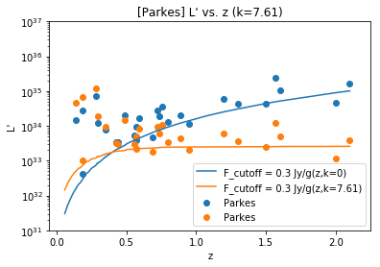
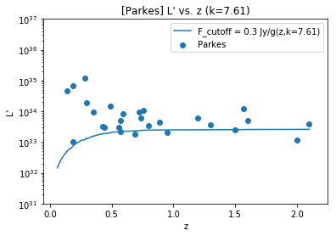
L vs. z and L’ vs. z
The bottom plot is the two plots on the right combined onto the same plot. You can see that the movement is up and down as expected, with more movement at higher z.

